Slide 1

Extendible Hashing and Indexing on Multiple Keys - Grid Files
SUJITH T S

Slide 2
CONTENTS
Introduction
Overview of Indexing
Hashing
Extendible Hashing
Grid Files
Conclusion

Slide 3
INTRODUCTION
Indexing is an essential component of database systems, allowing for faster and more efficient access to data, improving overall system performance and data integrity.
Extendible hashing and grid files are two indexing techniques commonly used in database systems for indexing on multiple keys.
This presentation aims to provide an overview of these techniques, including their benefits, drawbacks, and best practices for implementation.

Slide 4
Overview of Indexing
Indexing
Example
Importance of indexing
Types of indexing techniques

Slide 5
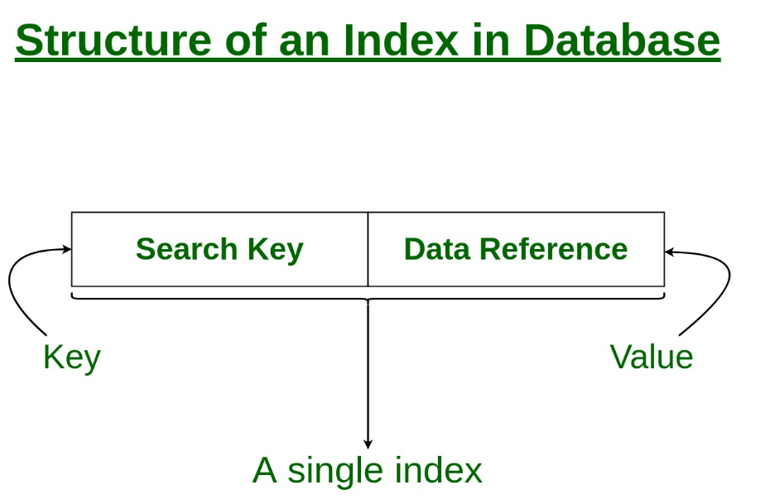
Indexing
Indexing is a way to optimize the performance of a database by minimizing the number of disk accesses required when a query is processed.
creating a mapping between the search keys and the physical locations of the corresponding data in the storage.
Index structures are the additional files on the disk
That provide an alternative ways to access the
record without affecting the physical placement
of records in the primary data file on the disk.

Slide 6
Employee
Emp_id | First_name | Last_name | department
CREATE INDEX emp_id_index ON employee (emp_id);
When a query is executed that involves searching for records based on the emp_id column, MySQL will use the index to quickly locate the corresponding records in the table.
(SELECT * FROM employee WHERE emp_id = 123; )
Without an index, MySQL would need to scan the entire employee table to find records with an emp_id of 123, which could be slow and resource-intensive for large tables.

Slide 7
Indexing is the process of organizing and retrieving data efficiently in a database system.
It enables faster access to data, allowing for faster query execution and better performance overall.
Without indexing, database systems would need to perform full table scans, which can be slow and resource-intensive.
Types of indexing techniques
B-tree indexing
Hash-based indexing, and multi-key indexing techniques such as extendible hashing and grid files

Slide 8
Hashing
What is hashing ?
Why hashing?
Collisions
Collision resolution technique
Goal of hashing function

Slide 9
HASHING
Hashing is a technique to convert a range of key values into a range of indices(hash /hash values) of an array by using hash function.
H : K → I
H - Hashing function
K - set of key values
I - range of indices

Slide 10





Hash Function
Key
Hash
A simple hashing approach would be to take the modular of the key (assuming it’s numerical) against the table’s size:
index=key MOD tableSize

Slide 11
Why hashing
Efficient data retrieval: Hashing allows for quick and efficient retrieval of data. Once the hash function has generated a unique hash code for a piece of data, the hash code can be used as a key to quickly locate and retrieve the original data from a hash table or other hash-based data structure.
Data security: Hashing is used in data security to protect sensitive information like passwords. Rather than storing the password itself, a hash value of the password is stored in a database. When a user attempts to log in, the password they enter is hashed and compared to the stored hash value. If the two values match, the user is granted access.
Data consistency: Hashing is also used to ensure data consistency. For example, when downloading a file from the internet, a hash value of the file may be provided alongside the file itself. By calculating the hash value of the downloaded file and comparing it to the provided hash value, the user can verify that the file has not been corrupted or modified during the download process.

Slide 12


Collisions
A collision occurs when the hash field value of a record that is being inserted hashes to an address that already contains a different record.
In this situation we must insert the new record in some other position .Since its hash address is occupied .The process of finding another position is called collision resolution.
Key 1
Same Hash
Hash Function
Key 2
Two keys can generate the same hash. This phenomenon is known as a collision.

Slide 13
Collision resolution technique
Closed Hashing
(open addressing)
Open Hashing
(closed addressing)
Linear Probing
Quadratic Probing
Double hashing
Chaining

Slide 14
Open addressing :
Proceeding from the occupied position specified by the hash address, the program checks the subsequent positions in order until an unused (empty) position is found.
Chaining :
For this method, various overflow locations are kept, usually by extending the array with a number of overflow positions.
- Additionally, a pointer field is added to each record location.
- A collision is resolved by placing the new record in an unused overflow
location and setting the pointer of the occupied hash address location to the
address of that overflow location.
- A linked list of overflow records for each hash address is thus maintained.
Multiple hashing :
The program applies a second hash function if the first results in a collision.
- If another collision results, the program uses open addressing or applies a
third hash function and then uses open addressing if necessary.
- Note that the series of hash functions are used in same order for retrieval.

Slide 15
GOAL OF HASHING FUNCTION
Hash function should distribute the record uniformly over the address space so as to minimize the collisions ,
Thus making the it possible to locate a record with a given key in a single access.
When a new record is added to a database, the hashing function is applied to the key value to calculate the index where the record should be stored. Similarly, when a record needs to be retrieved, the hashing function is applied to the key value to quickly locate the index where the record is stored.

Slide 16
Extendible Hashing
Extendible Hashing and main features
Need for extendible hashing
Basic Structure of Extendible hashing
Frequently used terms in Extendible Hashing
Basic working of Extendible Hashing
Example based on Extendible Hashing
Advantages of Extendible Hashing
Limitations of Extendible Hashing

Slide 17
Extendible Hashing
dynamic hashing technique that allows a database to grow or shrink dynamically as data is added or removed from the database.
This means that as more data is added to the database, the hash table can be expanded by adding more blocks to accommodate the new data. Similarly, as data is removed from the database, the hash table can be shrunk by removing blocks that are no longer needed.
Main features of Extendible Hashing:
Directories: The directories store addresses of the buckets in pointers. An id is assigned to each directory which may change each time when Directory Expansion takes place.
Buckets: The buckets are used to hash the actual data.

Slide 18
Need for extendible hashing
In static hashing, the size of the hash table is fixed when the database is created, and it cannot be easily changed without rebuilding the entire hash table. This means that if the size of the database grows beyond the capacity of the hash table, it is necessary to rebuild the entire table with a larger hash address space.
Similarly, if the size of the database shrinks significantly, the hash table may become too large for the amount of data being stored, which can lead to inefficiencies in accessing and storing data.
. Dynamic hashing techniques such as extendible hashing provide a solution to this problem, which uses a directory structure to dynamically allocate and reallocate blocks of data based on the number of records being stored.

Slide 19
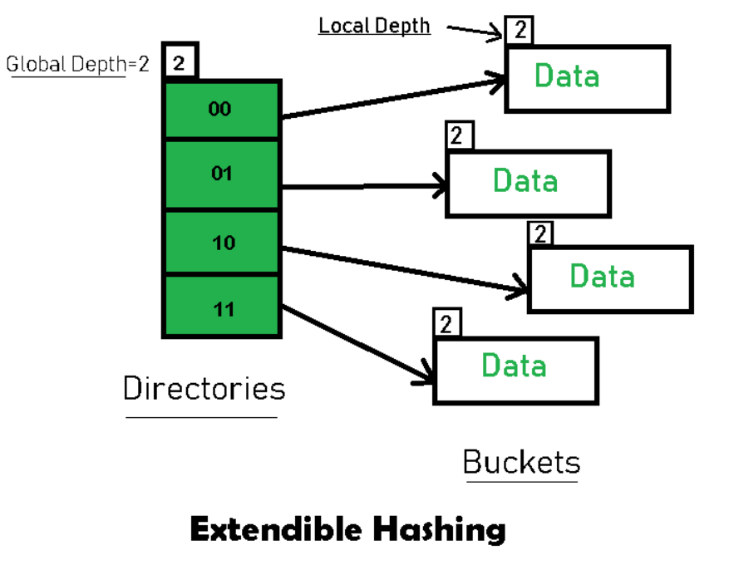
Basic Structure of Extendible Hashing:
each bucket contains a pointer to a block of data, and the directory contains pointers to the buckets.

Slide 20
Frequently used terms in Extendible Hashing
Directories: These containers store pointers to buckets. Each directory is given a unique id which may change each time when expansion takes place. The hash function returns this directory id which is used to navigate to the appropriate bucket. Number of Directories = 2^Global Depth.
Buckets: They store the hashed keys. Directories point to buckets. A bucket may contain more than one pointers to it if its local depth is less than the global depth.
Global Depth: It is associated with the Directories. They denote the number of bits which are used by the hash function to categorize the keys. Global Depth = Number of bits in directory id.

Slide 21
Local Depth: It is the same as that of Global Depth except for the fact that Local Depth is associated with the buckets and not the directories. Local depth in accordance with the global depth is used to decide the action that to be performed in case an overflow occurs. Local Depth is always less than or equal to the Global Depth
Bucket Splitting: When the number of elements in a bucket exceeds a particular size, then the bucket is split into two parts.
Directory Expansion: Directory Expansion Takes place when a bucket overflows. Directory Expansion is performed when the local depth of the overflowing bucket is equal to the global depth.

Slide 22
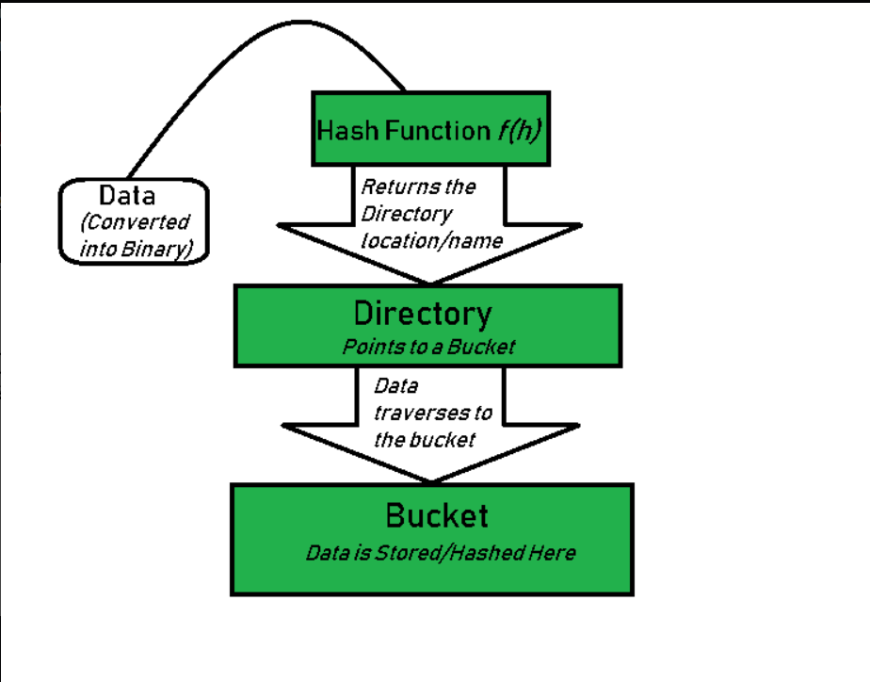
Basic working of Extendible Hashing

Slide 23
Initialize the bucket depths and the global depth of the directories.
Convert data into a binary representation.
Consider the "global depth" number of the least significant bits (LSBs) of data.
Map the data according to the ID of a directory.
Check for the following conditions if a bucket overflows (if the number of elements in a bucket exceeds the set limit):
Global depth == bucket depth: Split the bucket into two and increment the global depth and the buckets' depth. Re-hash the elements that were present in the split bucket.
Global depth > bucket depth: Split the bucket into two and increment the bucket depth only. Re-hash the elements that were present in the split bucket.
Repeat the steps above for each element.

Slide 24
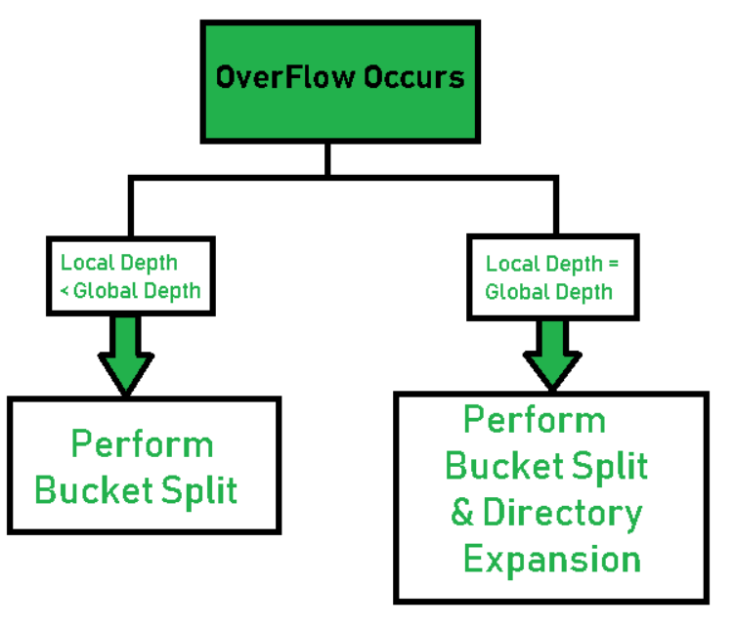

Slide 25
Example based on Extendible Hashing
Let consider a Employee table
Employee
Emp_id = { 16,4,6,22,24,10,31,7,9,20,26 } Bucket Size: 3 (Assume)
Hash Function: Suppose the global depth is X. Then the Hash Function returns X LSBs.
Emp_id | First_name | Last_name | department

Slide 26
Solution
First, calculate the binary forms of each of the given numbers.
16- 10000 26- 11010 10- 01010
4- 00100 20- 10100
6- 00110 9- 01001
22- 10110 7- 00111
24- 11000 31- 11111

Slide 27
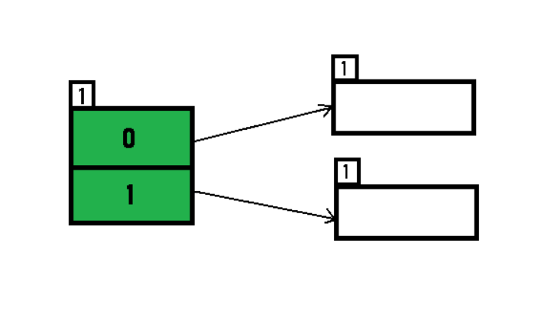
Initially, the global-depth and local-depth is always 1. Thus, the hashing frame looks like this:

Slide 28
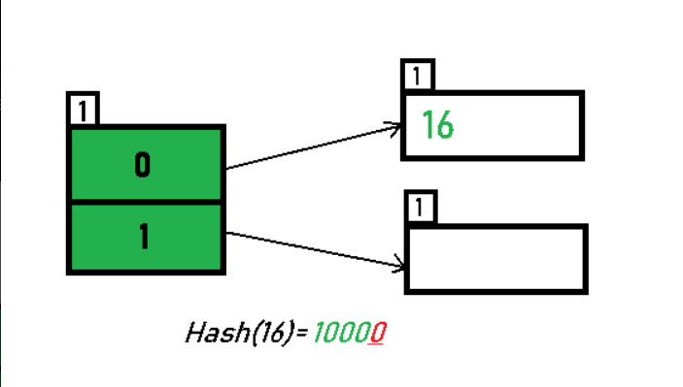
Inserting 16: The binary format of 16 is 10000 and global-depth is 1. The hash function returns 1 LSB of 10000 which is 0. Hence, 16 is mapped to the directory with id=0.

Slide 29
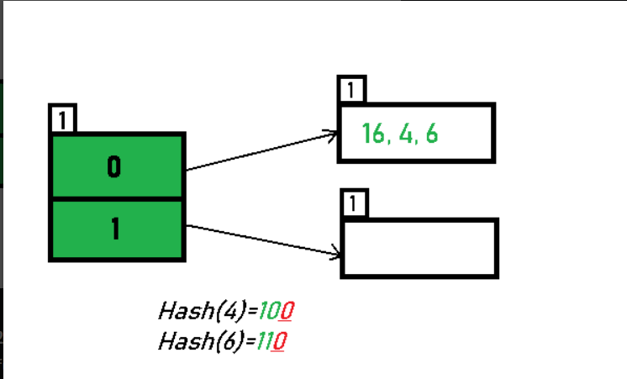
Inserting 4 and 6: Both 4(100) and 6(110)have 0 in their LSB. Hence, they are hashed as follows:

Slide 30
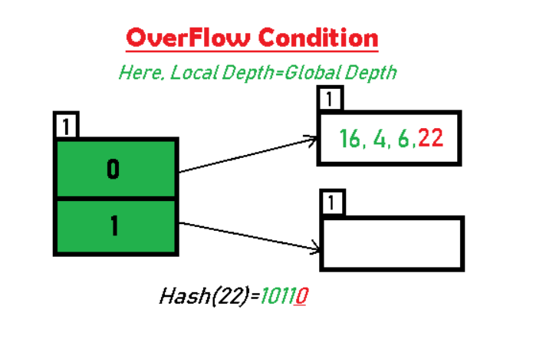
Inserting 22: The binary form of 22 is 10110. Its LSB is 0. The bucket pointed by directory 0 is already full. Hence, Over Flow occurs.

Slide 31
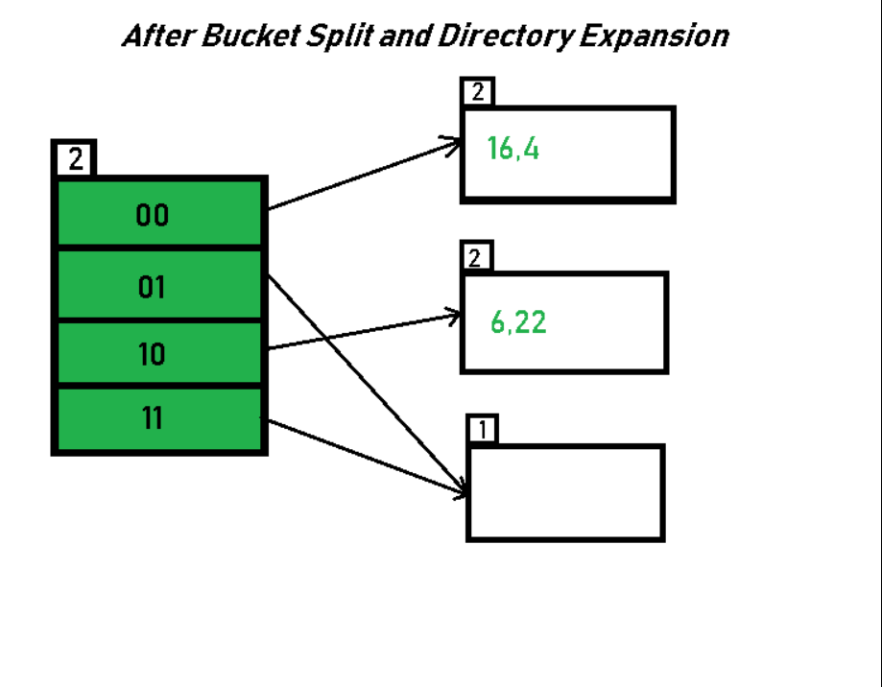
Since Local Depth = Global Depth, the bucket splits and directory expansion takes place. Also, rehashing of numbers present in the overflowing bucket takes place after the split.

Slide 32
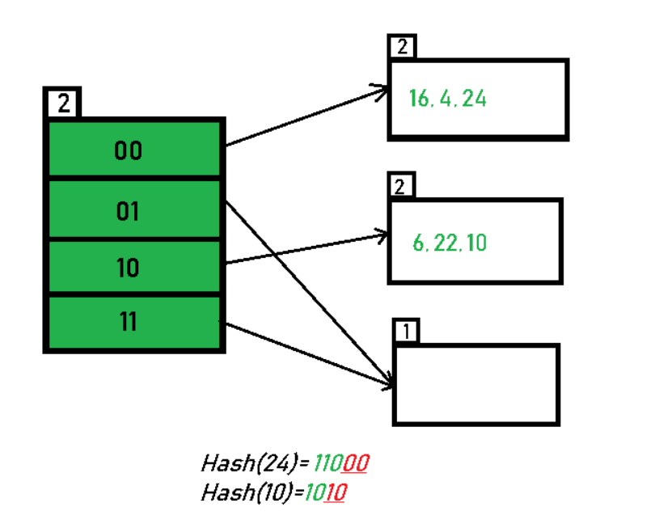
Inserting 24 and 10: 24(11000) and 10 (1010) can be hashed based on directories with id 00 and 10. Here, we encounter no overflow condition.

Slide 33
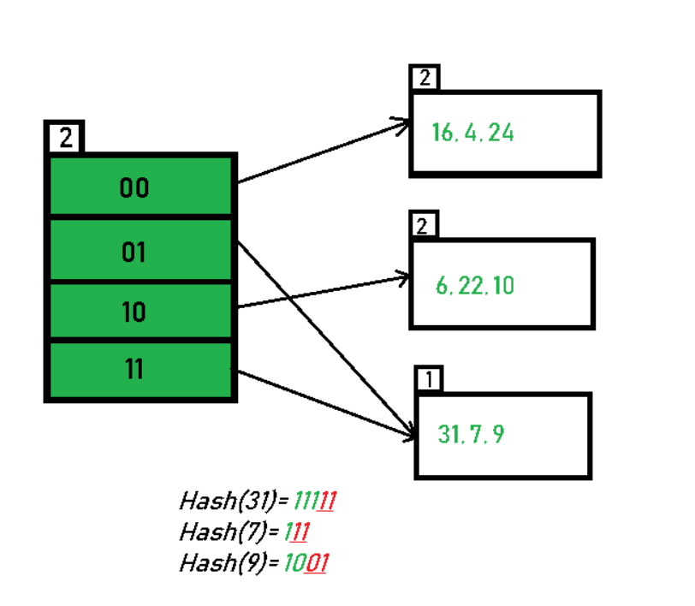
Inserting 31,7,9: All of these elements[ 31(11111), 7(111), 9(1001) ] have either 01 or 11 in their LSBs. Hence, they are mapped on the bucket pointed out by 01 and 11. We do not encounter any overflow condition here.

Slide 34
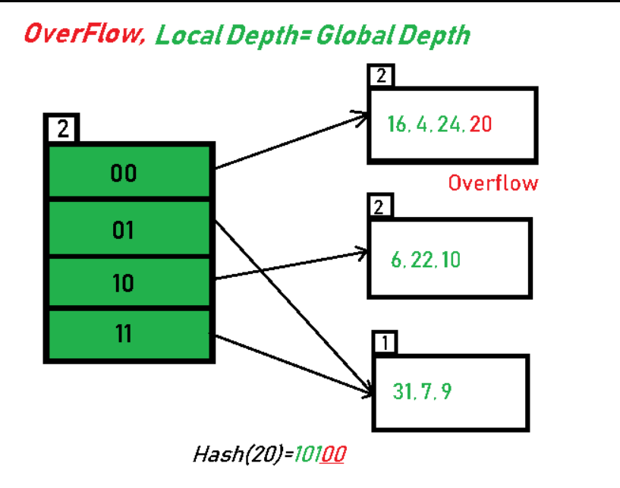
Inserting 20: Insertion of data element 20 (10100) will again cause the overflow problem.

Slide 35
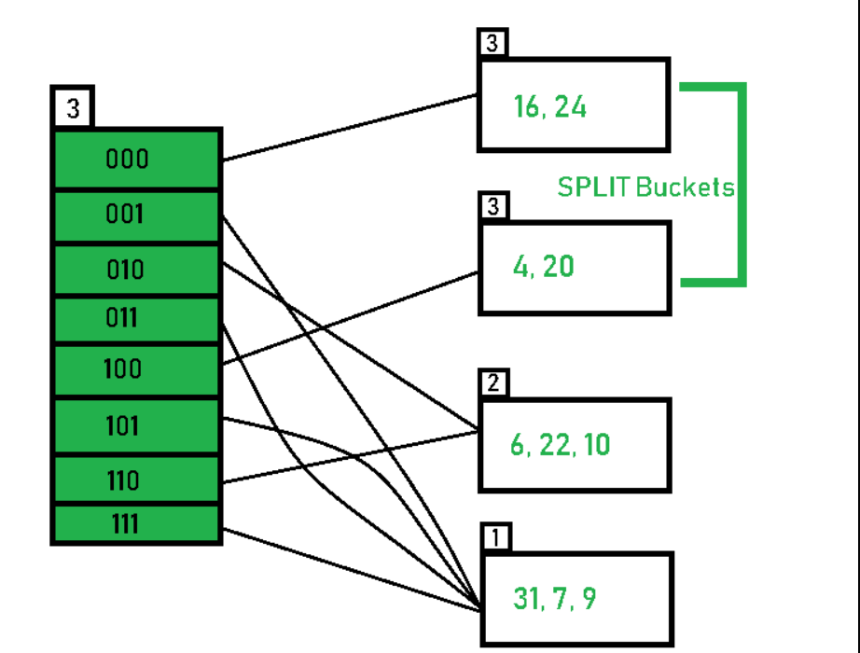
since the local depth of the bucket = global-depth, directory expansion (doubling) takes place along with bucket splitting. Elements present in overflowing bucket are rehashed with the new global depth.

Slide 36
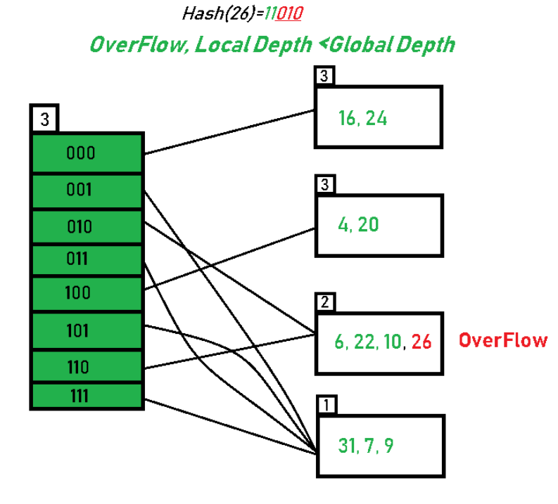
Inserting 26: Global depth is 3. Hence, 3 LSBs of 26(11010) are considered. Therefore 26 best fits in the bucket pointed out by directory 010.

Slide 37
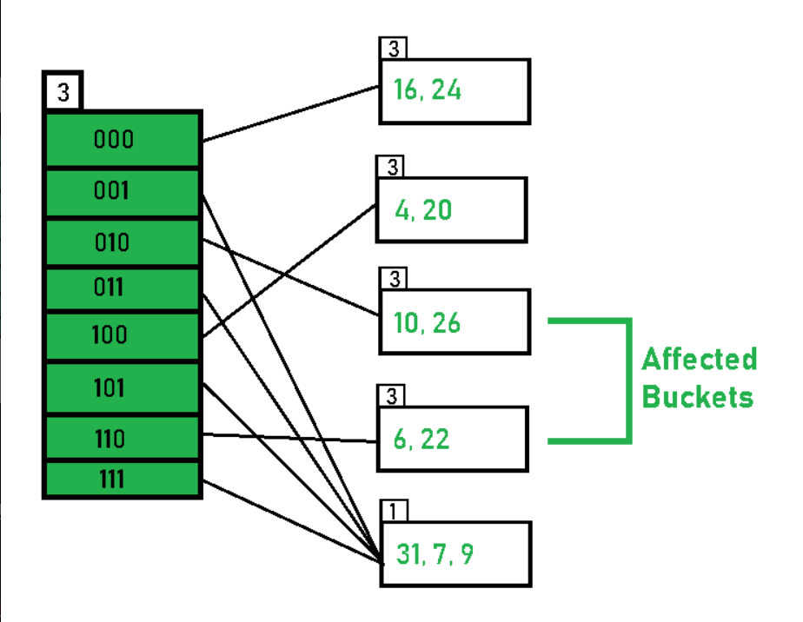
since the local depth of bucket < Global depth (2<3), directories are not doubled but, only the bucket is split and elements are rehashed.

Slide 38
Advantages of extensible hashing

Slide 39
Data retrieval is less expensive (in terms of computing).
No problem of Data-loss since the storage capacity increases
dynamically.
3.With dynamic changes in hashing function, associated old values are rehashed w.r.t the new hash function.

Slide 40
Limitations of Extendible Hashing

Slide 41
The directory size may increase significantly if several records are hashed on the same directory while keeping the record distribution non-uniform.
Size of every bucket is fixed.
Memory is wasted in pointers when the global depth and local depth difference becomes drastic.
This method is complicated to code.

Slide 42
Grid Files
What is Grid Files ?
Example
Operations related to a grid file structure.
Advantages and disadvantages

Slide 43
GRID FILES ?
Grid files are a type of indexing structure used to organize data. They partition the data space into a grid of cells and map data objects to the corresponding cells based on their location. Each cell in the grid is assigned a unique identifier, such as a pair of integers or a binary code, which is used to locate and access the data objects that are mapped to it.
Grid file indexing is the process of using grid files as an indexing structure to efficiently organize and retrieve data.

Slide 44
Operations related to a grid file structure
[1]Lookup:
This operation involves searching for and retrieving data based on a specific combination of criteria. In a grid file structure, lookup involves
1. Determining the position in the grid based on search criteria.
2. Accessing the corresponding bucket(s) in that position to retrieve or manipulate the records that match the search criteria.
[2]Insert:
This operation involves adding new records to the grid file structure.
To perform an insert operation, the structure needs to locate the needed bucket,
check if there is enough room(available space in a bucket where the record is to be inserted.), and insert the record.
If there is no room, the structure can create overflow blocks or split the structure by creating new grid lines.
if(space in bucket !=full)
insert the record ;
else{
create overflow blocks || split the structure by creating new grid lines;
insert the record;
}

Slide 45
[3]Splitting:
This operation involves creating new grid lines to split the structure into smaller parts.
Splitting can be necessary if there is no room to insert new records or if the structure needs to be reorganized.
However, splitting can create additional problems, such as linking the content of blocks across dimensions.
[4]Delete:
This operation involves removing records from the grid file structure.
To perform a delete operation,
1. each component of the tuple, determine the corresponding position in the grid structure.
2. Use the position information to locate the bucket that contains the record to be deleted
3.Delete the record, and reorganize if needed.

Slide 46
Organize the EMPLOYEE file as a Grid Files
If one wants to access a file on two keys ,say Dno and Age , he/she can construct a grid array with one linear scale for each of the search attributes.
5
4
3
2
1
0
0 1 2 3 4 5
Below figure shows a grid array one linear scale for Dno and another for the Age attribute.
Dno
0 1, 2
1 3,4
2 5
3 6,7
4 8
5 9, 10
Age
0 <20
1 20-25
2 26-30
3 31-40
4 41-50
5 >50

Slide 47
Linear scale for Dno
Dno
0 1, 2
1 3,4
2 5
3 6,7
4 8
5 9,10
Dno=1 and Dno=2 combined as one value 0 on the scale
Dno=3and Dno=4 combined as one value 1 on the scale
Dno =5 corresponds to the value 2 on the scale
…
Linear scale for Age
Age
Age is divided into its scale of 0 to 5 by grouping ages
So as to distribute the employees uniformly by age.
Age<20 corresponds to the value 0 on the scale
20<=Age>=25 corresponds to the value 1 on the scale
0 <20
1 20-25
2 26-30
3 31-40
4 41-50
5 >50

Slide 48
Interpretation of the given grid array
5
4
3
2
1
0
0 1 2 3 4 5
The Grid array shown for this file has a total 36 cells
Each cell points to some bucket address where the records corresponding to that cells are stored.
Each cell corresponds to a specific combination of Dno and Age criteria.
For example, the cell(0,0) corresponds to the combination of Dno=1,2 and Age<20, and contains some records that match this criteria. Similarly, the cell(1,0) corresponds to the combination of Dno=3 ,4 and Age<20, and contains some records that match this criteria.
Linear scale for Dno
Linear scale for Age

Slide 49
Thus the request for Dno =5 and Age = 25 maps into the cell (2,1) corresponding to the grid array.
The records for this combination will be found in the corresponding bucket.
This method is particularly useful for range queries that would map into a set of cells corresponding to a group of values along the linear scales.
5
4
3
2
1
0
0 1 2 3 4 5
(2,1)

Slide 50
Advantages of Grid Files
Fast Query Processing: Grid files are designed to efficiently handle multi-dimensional data, which makes them a good option for applications that require fast query processing.
Scalability: Grid files can be easily scaled up or down to accommodate changes in the amount of data being stored, which makes them a flexible and adaptable solution for applications with varying data storage requirements.
Easy to Implement: Grid files are relatively easy to implement compared to other data storage solutions like B-trees or Hash tables. They are also easier to understand and maintain, which makes them an attractive option for small to medium-sized data sets.

Slide 51
Disadvantages of Grid Files:
Grid files can have a high overhead in terms of storage space due to their grid structure.
They can become inefficient when handling high-dimensional data, resulting in decreased performance.
Choosing the right grid size can also be challenging, leading to poor performance if an inappropriate grid size is selected.

Slide 52
SUMMARY
hashing, grid files, and extendible hashing are powerful tools that can greatly enhance the efficiency and effectiveness of data management and retrieval in a wide range of applications.

Slide 53
THANK YOU

